Slide 1
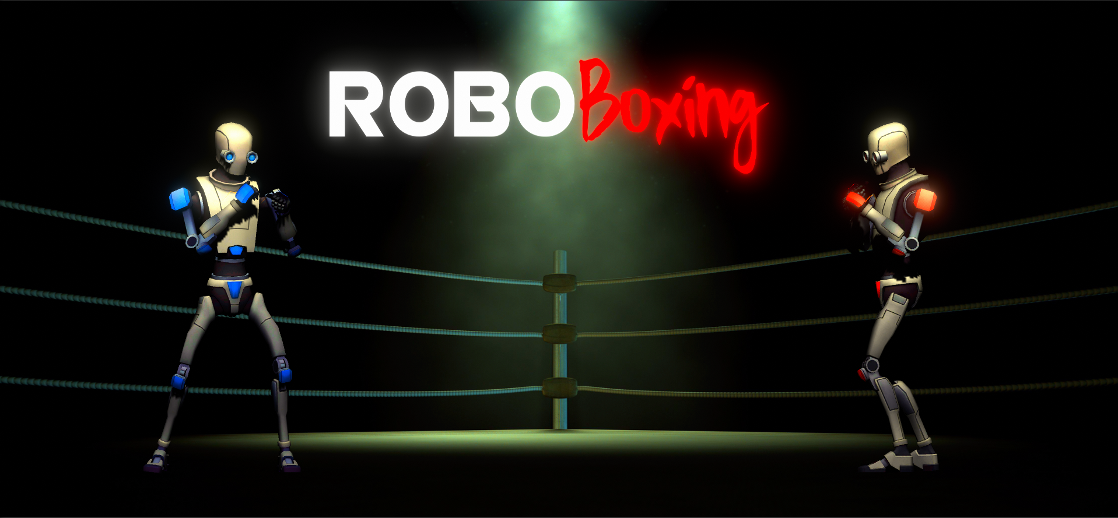
A Robot Fighting AR Game!
Christian Martínez, Jaume Montagut & Yessica Servin

Slide 2
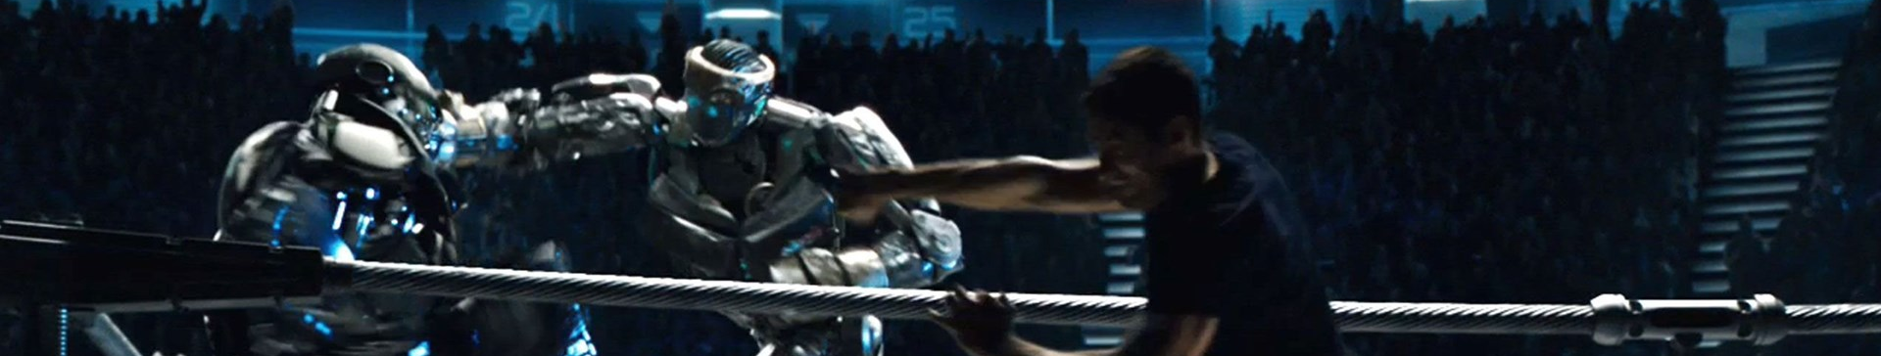
Goal
Win 3 rounds by bringing the enemy’s life bar to 0 HP.
Notes:
Yessica

Slide 3
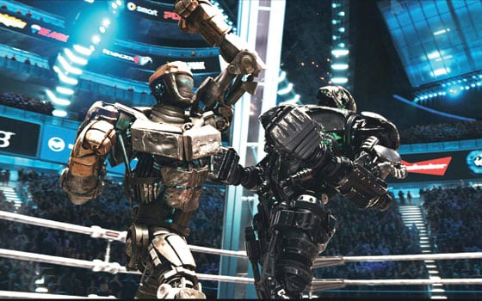
How to do it?
By punching it!
Punch on the Left or on the Right depending on where the enemy is
Notes:
Yessica

Slide 4
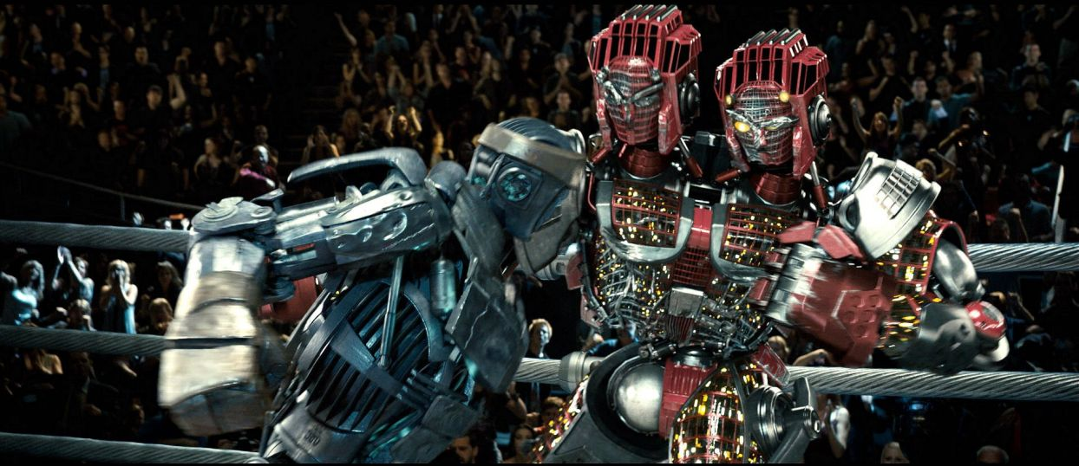
What’s in it?
Punches can be dodged!
Dodge where the enemy isn’t punching.
But be careful! The enemy can do it too.
Notes:
Yessica

Slide 5
Enemy AI
3 enemy AI
It gets harder each time you defeat it
Last one practically impossible to win (unless you have the necessary skills)
Notes:
Christian
Pero vendiendo humo un poco, como si hubieras programado la IA del siglo (como es random lo puede parecer)

Slide 6
Extra mechanic: Charged punch
Risk vs Reward
Charge more and do more damage but risk getting hit
Charge less and do less damage but safely
Feint (fintas): Hacer creer al otro que vas a darle un puñetazo)
Notes:
Jaume
Otras técnicas avanzadas:
Darle mientras se recupera del hit
Hacerle creer que vas a atacar y darle cuando vuelve del dodge
En general hemos intentado que sea profundo con las mínimas mecánicas

Slide 7
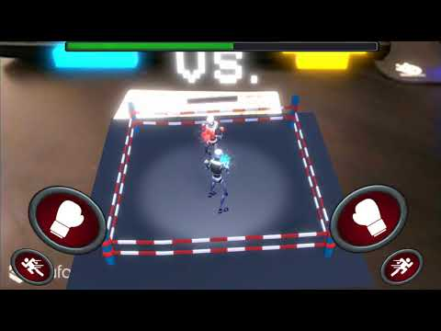
Video

Slide 8
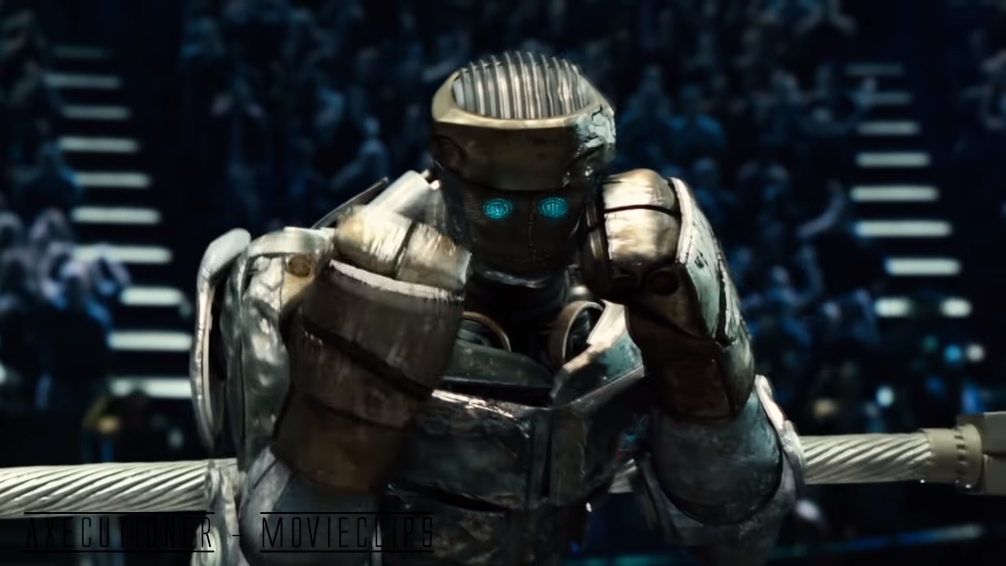
Are you ready to fight?
Christian Martínez
Jaume Montagut
Yessica Servin

Slide 9
